Slide 1

Mobile Camera Application to Monitor Residential Society Vehicle Activity
PIP2001 Capstone Project
Review-2
Batch Number: CEI-17
Student Name | Roll Number
Under the Supervision of,
Dr. Debasmita Mishra
Professor
School of Computer Science and Engineering
Presidency University
Name of the Program: CEI
Name of the HoD: Dr. Gopal Krishna Shyam
Name of the Program Project Coordinators: Dr. Sudha P
Name of the School Project Coordinators: Dr. Sampath A K / Dr. Abdul Khadar A / Mr. Md Ziaur Rahman

Slide 2
Introduction of our Project
The project is focused on developing an ML-enabled automated surveillance and visitor management system for residential societies. The primary goal is to integrate image processing and machine learning to automate the recognition of vehicles, authenticate residents and visitors, and manage access control seamlessly. With the growing demand for secure and efficient surveillance, this project aims to provide a solution that utilizes Automatic Number Plate Recognition (ANPR) and a backend database to identify and authorize entry while keeping records of visitors.

Slide 3
Literature Review
“ML Enabled Surveillance System for Societies”
Author : Mr. Pranav Chauhan, Mr. Sachin Gupta, Mr. Rohit Arava, Dr. Sameer Nanivadekar, Prof. Vishal Badgujar
Algorithm Used:
Convolutional Neural Networks (CNNs): Used for both face and vehicle recognition. CNNs help in identifying and classifying objects in images, like recognizing residential or non-residential vehicles and distinguishing residents from outsiders based on facial features.
Drawbacks:
Dependency on Clear Images: OCR and face recognition algorithms are heavily reliant on clear and well-lit images. The system may struggle with low-quality images, dark environments, or poor lighting conditions, which can reduce the accuracy of vehicle and face recognition.

Slide 4
Literature Review
“Autonomous Vehicle Implementation Predictions”
Author : Todd Litman
Algorithm Used:
OpenCV for Face Recognition: OpenCV libraries, along with deep learning models, are used for face detection and recognition. It includes steps like extracting face embeddings, training a recognition model, and identifying people in real-time footage.
Drawbacks:
High Costs: Autonomous vehicles require expensive equipment, maintenance, and infrastructure.
Risk of Increased Traffic: Autonomous vehicles may increase total vehicle travel, potentially worsening congestion, pollution, and sprawl.

Slide 5
Literature Review
“IoT-Enabled Vehicle Speed Monitoring System”
Author : Shafi Ullah Khan, Noor Alam, Sana Ullah Jan, In Soo Koo
Algorithm Used:
License Plate Detection: Utilizes OpenCV for image processing, specifically contours to detect license plates in still images or video frames. The captured image is processed through grayscale conversion, bilateral filters, and edge detection.
Drawbacks:
Camera Visibility Constraints: The system may struggle with accurately identifying vehicles when two cars are too close or obscured from view, leading to potential inaccuracies in detection.
Environmental Limitations: Adverse weather conditions can reduce the accuracy of image-based recognition, impacting license plate detection.

Slide 6
Research Gaps Identified
Traditional surveillance systems are limited in scalability, real-time processing, and intelligent decision-making.
There is a lack of fully automated systems that can combine vehicle recognition, visitor authentication, and access management.
Existing solutions do not fully leverage the potential of deep learning for high-accuracy vehicle detection and character recognition on number plates.
Limited integration of ANPR technology with visitor management systems for seamless access control in residential areas.

Slide 7
Proposed Methodology
License Plate Detection: Using pre-trained models for vehicle detection and YOLO (You Only Look Once) algorithms for real-time plate recognition.
Character Recognition on Plates: Machine learning models trained to recognize alphanumeric characters on license plates.
Resident and Visitor Verification: Checking the recognized license plate number against a database of residents and visitors, enabling automated access for residents and logging entries for visitors.
Centralized Dashboard: A web-based dashboard to manage data, visualize logs, and send alerts.

Slide 8
Objectives
Enhance Security: Improve security in residential societies through real-time monitoring and automated logging of vehicle entries and exits.
Cost-Effective Solution: Provide a high-quality vehicle monitoring system that remains affordable for medium and small societies.
Ease of Use: Ensure a user-friendly interface for security personnel and residents.
Scalability: Design the system to be easily expandable, allowing additional cameras or modules as needed.

Slide 9
Methodology/Modules
Vehicle Detection Module: Detects incoming vehicles and isolates license plates for recognition.
License Plate Recognition Module: Uses machine learning to recognize characters on the license plate, converting images into text.
Resident Verification Module: Checks detected plate numbers against a database to verify residents and log visitor entries.
Alert System: Sends real-time alerts if unauthorized vehicles are detected.
Database and Logging Module: Maintains records of entries and exits, accessible through a web interface.

Slide 10
System design and Implementation
The system is structured around a client-server model where the vehicle detection module is deployed at the entry points and communicates with a central server. Key technologies include:
Django Framework: Used for developing the web interface and managing database interactions.
OpenCV: For real-time image processing and video frame analysis.
TensorFlow/Keras: For deep learning models that recognize characters on the license plate.
MySQL Database: To store resident, visitor, and log information.

Slide 11
Architecture
The architecture consists of:
Input Layer: Cameras capture vehicle images and send them to the processing module.
Processing Layer: Image processing and recognition happen here, including license plate detection and character recognition.
Database Layer: Stores resident and visitor information, along with logs of all entries and exits.
Dashboard Layer: Provides a user interface for monitoring and management.

Slide 12
Hardware/software components
Hardware:
Moderate-spec computer or Raspberry Pi for processing, CCTV cameras for capturing images, and a router for networking.
Software
Django,
TensorFlow/Keras,
OpenCV,
MySQL,
Python.

Slide 13
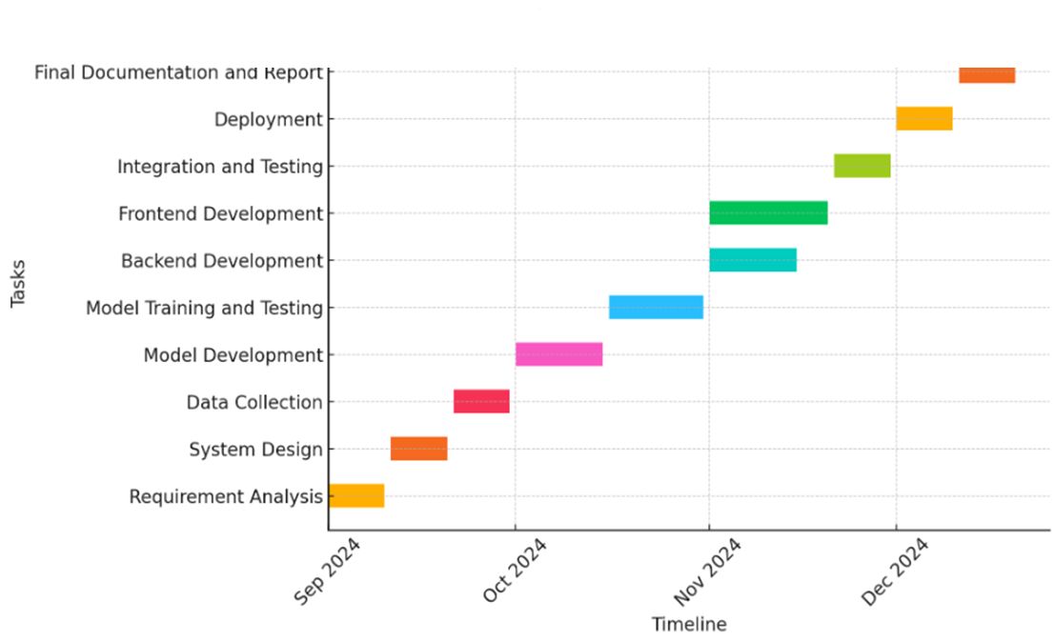
Timeline of Project

Slide 14
Expected Outcomes
Automated Vehicle Monitoring: Reduce manual intervention and streamline vehicle entry management in residential areas.
Real-Time Alerts: Immediate notification of unauthorized vehicles.
Enhanced Security Records: Comprehensive logging of entries and exits, accessible via a dashboard.
Cost-Effective Implementation: High functionality at a fraction of the cost of traditional systems.

Slide 15
Conclusion
This project provides an innovative and affordable approach to vehicle monitoring for residential societies, leveraging machine learning and image processing for real-time, automated recognition of vehicles and license plates.
By eliminating the need for high-end hardware and manual processes, this solution offers a cost-effective alternative to traditional monitoring systems while significantly enhancing security, accountability, and operational efficiency in residential communities.

Slide 16
References
Pranav Chauhan, Sachin Gupta, Rohit Arava, Sameer Nanivadekar, Vishal Badgujar. “ML Enabled “Surveillance System for Societies.”
Todd Litman. “Autonomous Vehicle Implementation Predictions.”
Shafi Ullah Khan, Noor Alam, Sana Ullah Jan, In Soo Koo. “IoT-Enabled Vehicle Speed Monitoring Systems.”
Patel, A., Desai, K., Shah, R., & Sharma, M. "A Deep Learning Approach to Real-Time Vehicle Detection and Classification in Smart Cities." Journal of Urban Technology.
Smith, J., Lee, H., & Wang, X. "AI-Driven Autonomous Surveillance Systems for Public Safety." International Journal of Computer Vision and Applications.

Slide 17
Publication Details

Slide 18

Thank You

